Slide 1
Biçimsel Diller ve Otomata Teorisi
Formal languages and automata theory
PAMUKKALE ÜNİVERSİTESİ
MÜHENDİSLİK FAKÜLTESİ
BİLGİSAYAR MÜHENDİSLİĞİ BÖLÜMÜ
2020 BAHAR

Slide 2
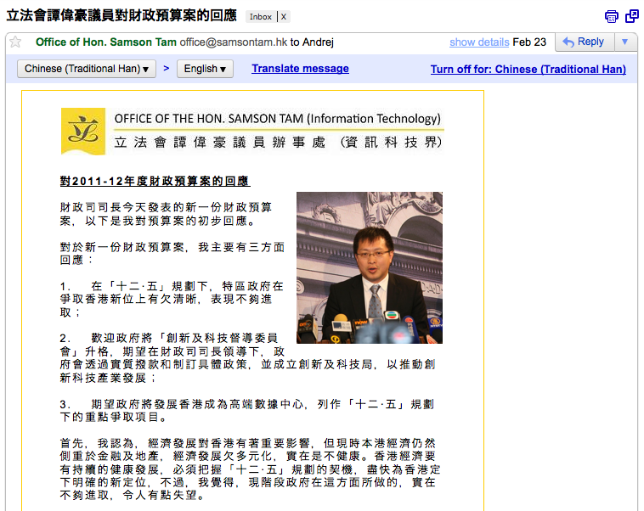
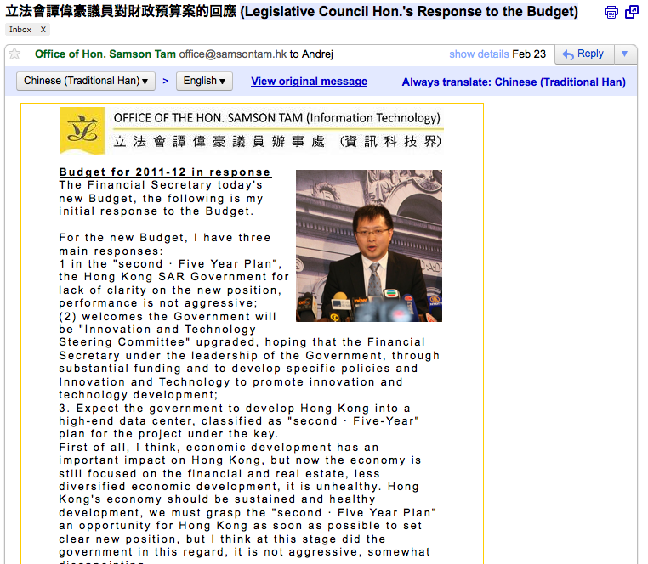
Google is amazing

Slide 3
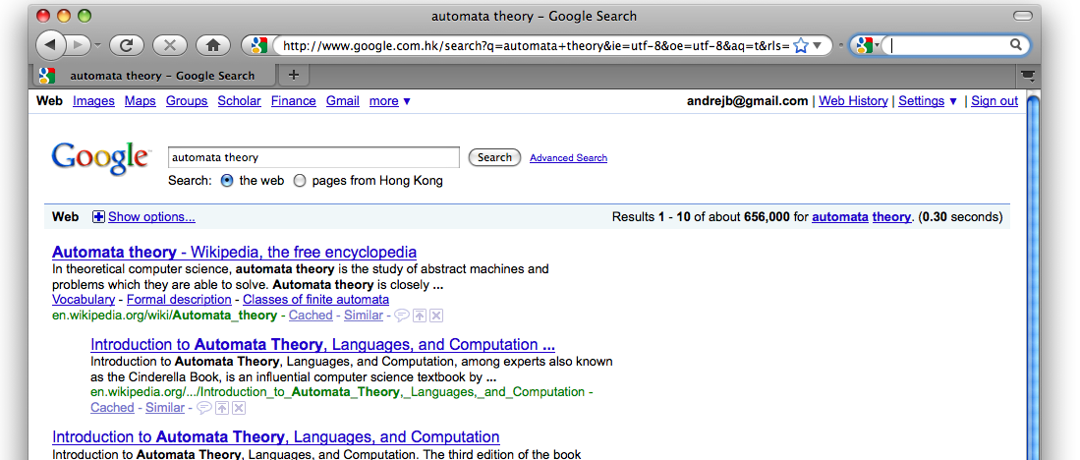
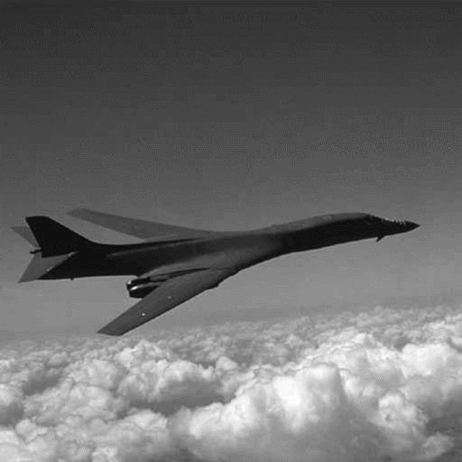
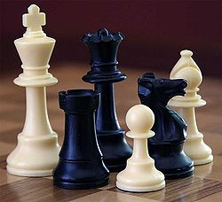
What else?
Search
Fly
Play chess
Is there anything a computer cannot do?

Slide 4
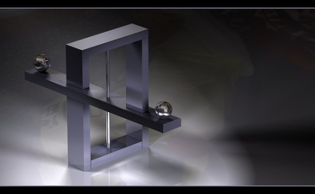
Impossibilities
Why do we care about the impossible?

Slide 5
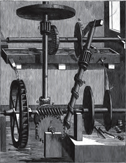
Perpetual motion
In the middle ages, people wanted a machine that does not use any energy
Later, discoveries in physics showed that energy cannot be created out of thin air
Perpetual motion is a futile endeavor
Understanding the impossible helps us
channel our energies towards the more useful.

Slide 6



The laws of computation
Just like the laws of physics tell us
what is (im)possible for nature to do...
...the laws of computation tell us
what is (im)possible for computers.

Slide 7
What is automata theory
Automata theory studies the laws of computation.
Automata theory is the study of abstract computational devices
Abstract devices are (simplified) models of real computations
Computations happen everywhere: On your laptop, on your cell phone, in nature, …
Why do we need abstract models?
In reality, the laws of computation are not understood,
but automata theory is a good start.

Slide 8
A simple computer
SWITCH
BATTERY
input: switch
output: light bulb
actions: flip switch
states: on, off

Slide 9
A simple “computer”
SWITCH
f
BATTERY
start
on
off
f
input: switch
output: light bulb
actions: f for “flip switch”
states: on, off
bulb is on if and only if there was an odd number of flips

Slide 10
Another “computer”
1
1
start
off
off
1
BATTERY
2
2
2
2
1
2
off
on
1
inputs: switches 1 and 2
actions: 1 for “flip switch 1”
actions: 2 for “flip switch 2”
states: on, off
bulb is on if and only if both switches were flipped an odd number of times

Slide 11
A design problem
1
?
4
5
BATTERY
2
3
Can you design a circuit where the light is on if and only if all the switches were flipped exactly the same number of times?

Slide 12
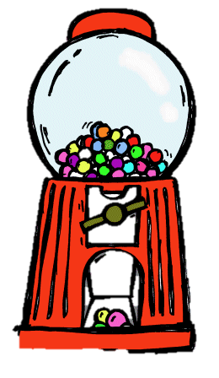
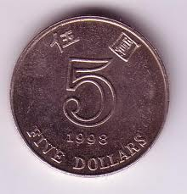
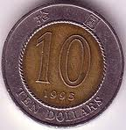
A gumball machine
machine takes $5 and $10 coins
a gumball costs $15
actions: +5, +10, Release
一五
+10
+10
+5
+5
+5, +10
$0
$5
$10
R
R
R
+5, +10
R

Slide 13
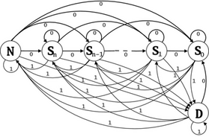
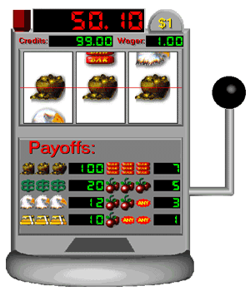
Slot machine
=

Slide 14
What is the difference?
Such questions are difficult to reason about, because devices can be designed in infinitely many ways
Automata theory will help answer (some of) them

Slide 15
What can automata do
They can describe the operation of a small device
They can be used to verify (simple) software*
They are used in lexical analyzers to recognize expressions in programming languages:
ab1 is a legal name of a variable in java
5u= is not

Slide 16
Different kinds of machines
+10
+10
+5
+5
+5, +10
$0
$5
$10
R
R
R
+5, +10
R
This was only one example of a machine
We will look at different kinds of machines and ask:
  What kinds of problems can this kind of machine solve?
  What things are impossible for this kind of machine?
  Is machine A more powerful than machine B?

Slide 17
Some kinds of machines
finite automata | Devices with a small amount of memory. Used to model very simple things.
push-down automata | Devices with infinite memory that can be accessed in a restricted way. Used to parse grammars
Turing Machines | Devices with infinite memory. These are the real computers
time-bounded Turing Machines | Infinite memory, but bounded running time. These are computers that run reasonably fast.

Slide 18
Some highlights of the course
Finite automata
  Automata are closely related to the task of searching for patterns in text
Grammars
  Grammars describe the meaning of sentences in English, and the meaning of programs in Java
  We will see how to extract the meaning out of a program
find (ab)*(ab) in abracadabra

Slide 19
Some highlights of the course
Turing Machines
  This is a general model of a computer, capturing anything we could ever hope to compute
  But there are many things that computers cannot do:
Given the code of a computer program, can you
tell if the program prints the string “banana”?
#include <stdio.h>
main(t,_,a)char *a;{return!0<t?t<3?main(-79,-13,a+main(-87,1-_,
main(-86,0,a+1)+a)):1,t<_?main(t+1,_,a):3,main(-94,-27+t,a)&&t==2?_<13?
main(2,_+1,"%s %d %d\n"):9:16:t<0?t<-72?main(_,t,
"@n'+,#'/*{}w+/w#cdnr/+,{}r/*de}+,/*{*+,/w{%+,/w#q#n+,/#{l,+,/n{n+,/+#n+,/#\
;#q#n+,/+k#;*+,/'r :'d*'3,}{w+K w'K:'+}e#';dq#'l \
q#'+d'K#!/+k#;q#'r}eKK#}w'r}eKK{nl]'/#;#q#n'){)#}w'){){nl]'/+#n';d}rw' i;# \
){nl]!/n{n#'; r{#w'r nc{nl]'/#{l,+'K {rw' iK{;[{nl]'/w#q#n'wk nw' \
iwk{KK{nl]!/w{%'l##w#' i; :{nl]'/*{q#'ld;r'}{nlwb!/*de}'c \
;;{nl'-{}rw]'/+,}##'*}#nc,',#nw]'/+kd'+e}+;#'rdq#w! nr'/ ') }+}{rl#'{n' ')# \
}'+}##(!!/")
:t<-50?_==*a?putchar(31[a]):main(-65,_,a+1):main((*a=='/')+t,_,a+1)
:0<t?main(2,2,"%s"):*a=='/'||main(0,main(-61,*a,
"!ek;dc i@bK'(q)-[w]*%n+r3#l,{}:\nuwloca-O;m .vpbks,fxntdCeghiry"),a+1);}
?
banana

Slide 20
Some highlights of the course
Time-bounded Turing Machines
  Many problems are possible to solve on a computer in principle, but take too much time in practice
  Traveling salesman: Given a list of cities, find the shortest way to visit them and come back home
  Hard in practice: For 100 cities, this would take 100+ years even on the fastest computer!
Beijing
Los Angeles
Baku
Shanghai
Istanbul
Hong Kong

Slide 21
Preliminaries of automata theory
How do we ask the question
First, we need a way of describing the problems that we are interested in solving
Can machine A solve problem B?

Slide 22
Problems
Examples of problems we will consider
  Given a word s , does it contain “to” as a subword?
  Given a number n , is it divisible by 7?
  Given two words s and t , are they the same?
All of these have “yes/no” answers.
There are other types of problems, like “Find this” or “How many of that” but we wont look at them.

Slide 23
Satisfactory mathematical background.
No specific area is required, but the course is mathematical in its nature.
If you would like to refresh your memory about
  functions and relations,
  sets, enumerability or proofs by induction,
  you should attend the first lecture.
The courses Discrete Mathematics and Data Structures support the studies for this course.

Slide 24
Course Evaluation Criteria
Midterm : %40
Final : %60
Homeworks: for extra credit
Attendance requirements: students responsibility

Slide 25
References
Notes will be provided for every lecture at EDS (education support system).
The following references cover some of the topics in more detail.
Can be obtained from gen.lib.rus.ec
MAIN BOOK:
Elements of the Theory of Computation, by Lewis and Papadimitrou, second edition, 1998.
SUPPLEMENTARY:
Introduction to the Theory of Computation, second edition, by Michael Sipser
Introduction to Automata Theory, Languages, and Computation, 3rd edition, by John Hopcroft, Rajeev Motwani, and Jeffrey Ullman
Elements of Computation Theory, Arindrama Singh
Theory of Computing. A Gentle Introduction, Efim Kinber & Carl Smith
Video lectures by Shai Simonson.
www.class-central.com Stanford University Automata Theory Course, Video lectures from the great Jeffrey Ullman
GitHub - yurifw/Visual-Automata-Simulator by Jean Bovet
https://www2.cs.duke.edu/csed/jflap/ form Duke University

Slide 26
Contents of the Course
Introduction
  Presentation of the Course
  Repetition of Data Structures and Basic Mathematical Concepts
  Computational Problems and Solvability
Regular Languages and Finite Automata
  Deterministic Finite Automata
  Minimization of Finite Automata
  Nondeterministic Finite Automata
  Determinization of Automata
  Regular Expressions and Languages
  Restrictions of Regular Languages: the Pumping Lemma
Context-free Languages and Pushdown Automata
  Context-free Grammars and Languages
  The Parsing Problem for Grammars
  Recursive Parsing
  The CYK Parsing Algorithm
  Pushdown Automata
  Restrictions of Context-free Languages
Introduction to Theory of Computation
  Unrestricted grammars
  Turing Machines
  Decidability

